Slide 1

MD Simulator
Final Project of APC 523
Bingjia Yang
https://github.com/iceplussss/APC523Project
Cover art generated by Disco Diffusion v5.2
keywords: a single molecule, ocean, lonely, cyberpunk, by watercolor)

Slide 2
Outline
Introduction
Mathematical Model
Velocity Verlet Algorithm
Force Field
Software Architecture
Inputs
Simulation
Outputs
Examples
Case Study
Benchmark
Summary and Outlook

Slide 3
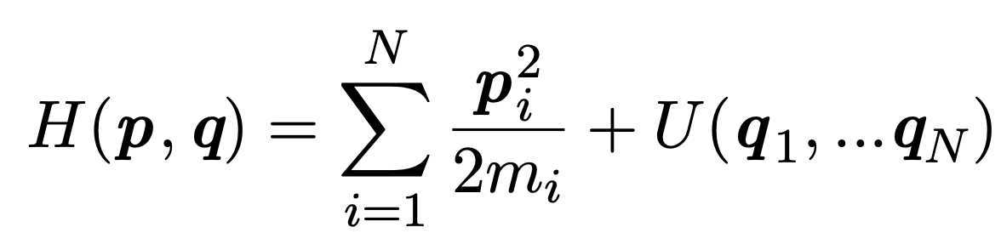
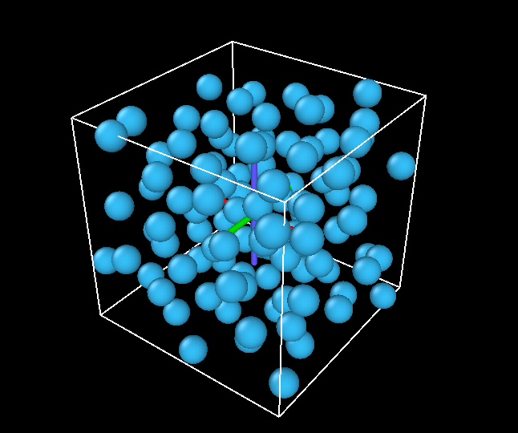
Introduction
Consider a classical system composed of N atoms
MD Simulator is written in python and the main dependencies are python packages Numpy and ASE. It can perform molecular dynamics simulation for a given simulated ensemble and force field.

Slide 4
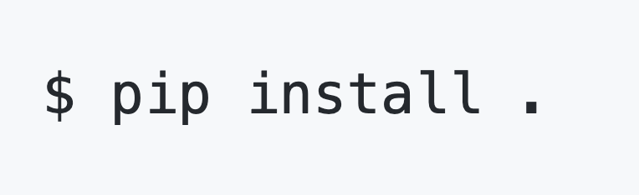
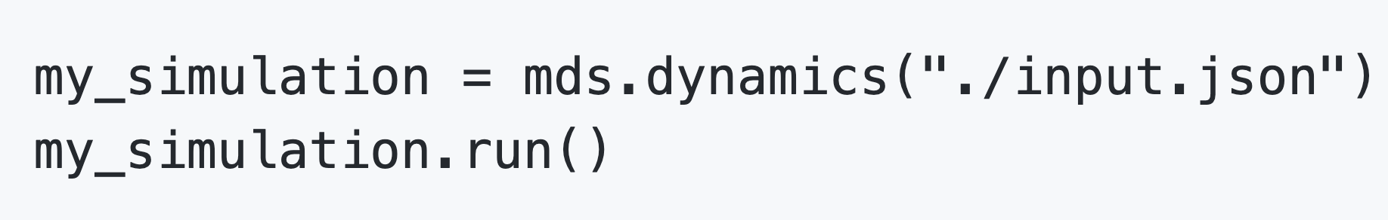
Introduction
- Installation
The user could install MDS using pip:
- Getting Started
To run a simulation using MDS, the user should first initialize a dynamics object. The argument is the path of the input json file.

Slide 5
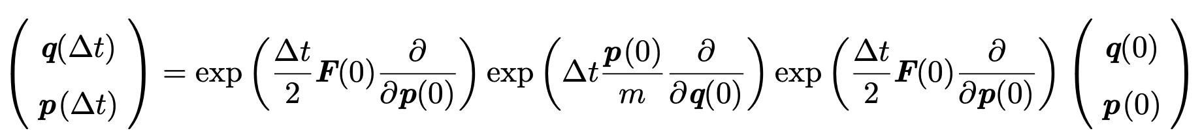
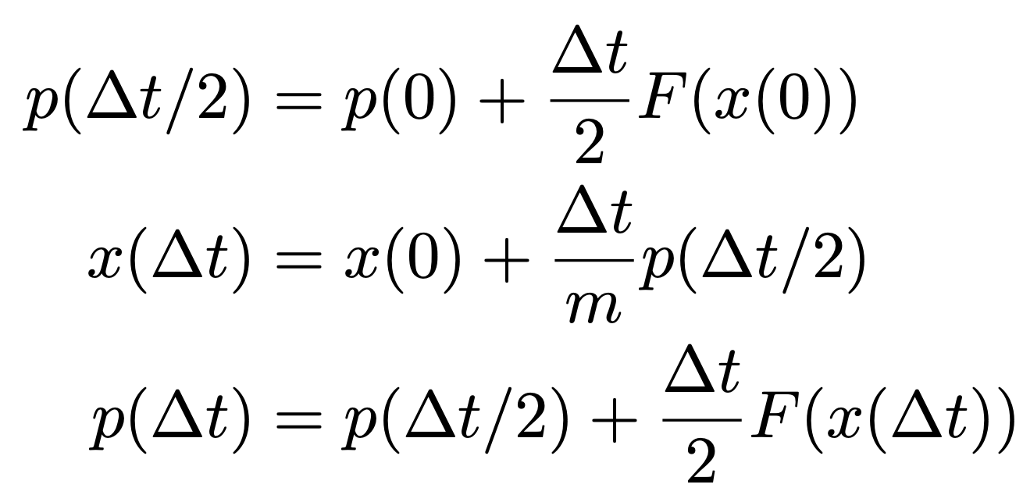
Mathematical Model: Velocity Verlet Algorithm
The evolution of the system can be expressed as
For an example of a single particle moving in one dimension, velocity Verlet algorithm can be expressed as a three-step procedure:
Time-reversible and Symplectic
Tuckerman, Mark., 2010. Statistical mechanics: theory and molecular simulation. Oxford university press

Slide 6
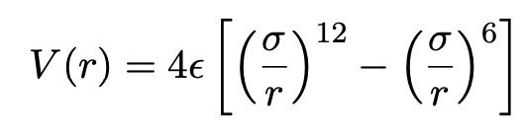
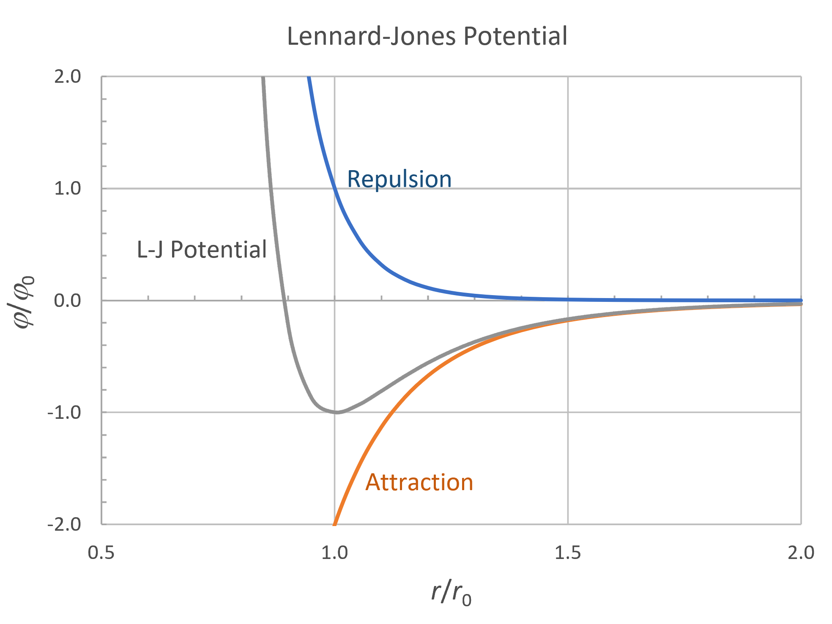
Mathematical Model: Force Field
In this work, we take the Lennard-Jones potential as an example.
image cr: https://polymerdatabase.com/polymer%20physics/Lennard-Jones.html

Slide 7
Software Architecture: Inputs
The user should prepare a json input file determining the initial configuration of the system as well as the simulation parameters. Currently, we support following key words:
mode | defines the simulated ensemble, e.g. nve
init_temp | initial temperature used to create random velocities for all atoms
time_step | the amount of time by which the integrator steps, unit: fs
total_steps | total simulation time is just total_steps multiplied by time step
init_conf_path | initial configurations (format: xyz) provided by the user
ff_style | defines which force field is used, e.g. lj
ff_coeff | a list of force fields coefficients, e.g. [ε, σ, cutoff] for lj
log_freq | sets the frequency to print thermodynamic information
dump_freq | sets the frequency to dump a snapshots of the system

Slide 8
Software Architecture: Simulation
dynamics
After parsing the json input file, a system object is initialized to contain atomic information
system and all simulation parameters are then stored in a dynamics object
system
update
lj
Outputs:
- log file
- dump files
update performs time integration
At current stage, only micro-canonical ensemble (NVE) and Lennard-Jones potential are implemented.

Slide 9
Software Architecture: Outputs
There are two kinds of outputs in this program:
Log file | a list of thermodynamic observables printed every log_freq steps to a single text file. The default is time step, potential energy, kinetic energy, total energy and cell volume.
Dump files | snapshots of atoms which are printed every dump_freq steps to separate xyz files. These files could be then easily imported to visualization softwares like OVITO for analysis.

Slide 10
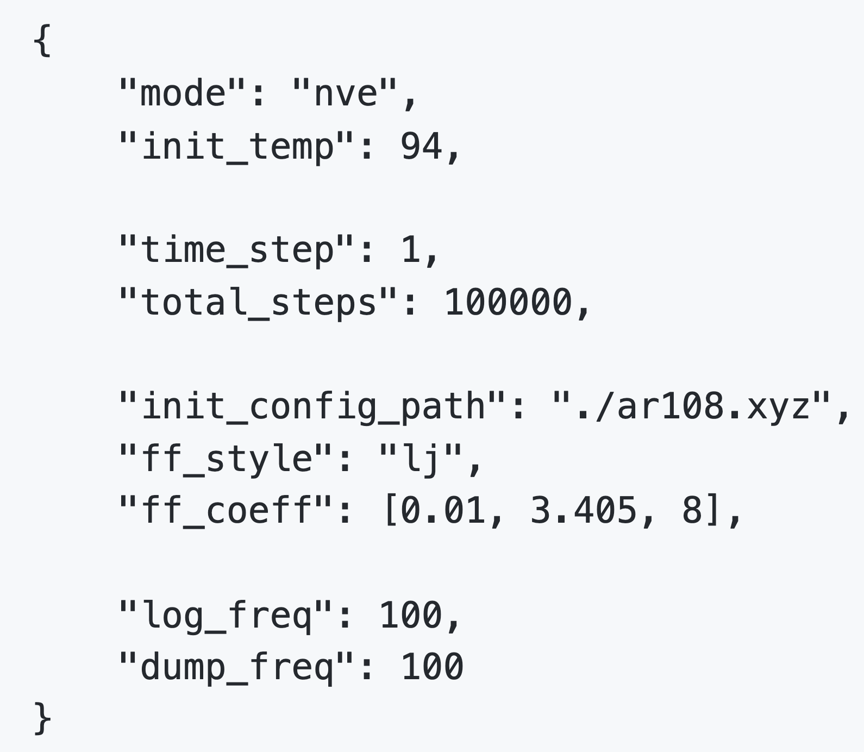
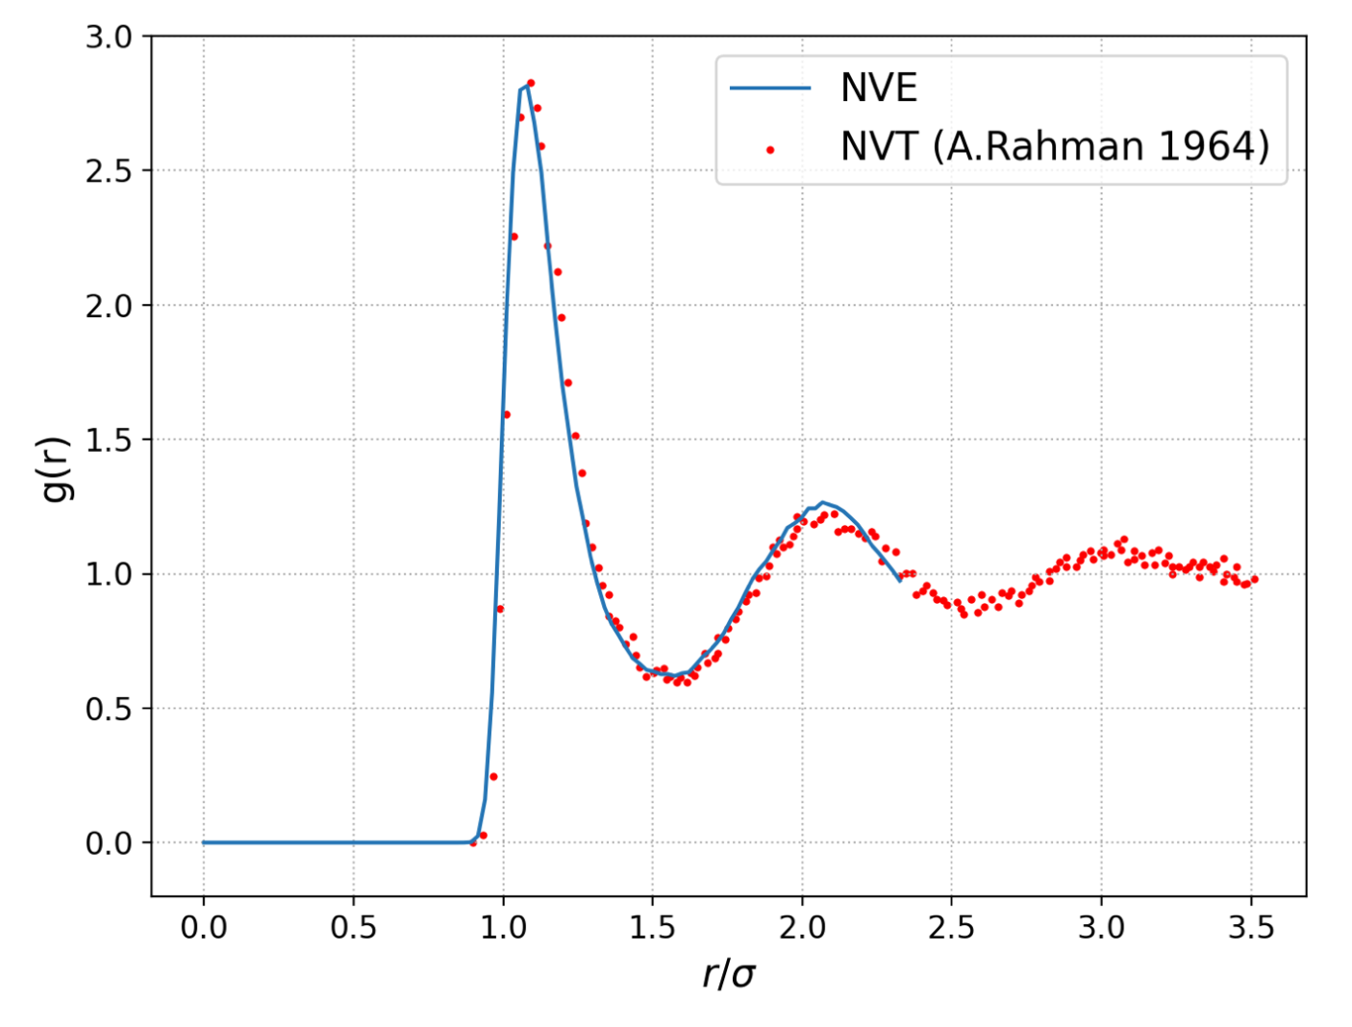
Examples: Case study
Data at ./example/argon_rdf/backup_results
A sample problem: 108 Ar atoms interacting with Lennard-Jones potential (coefficients: ε = 0.01eV, σ = 3.405 ̊A and cutoff=8 ̊A).
The json input is as follows:
The Radial distribution function (RDF) calculated by MDS using NVE ensemble shows a good agreement with the reference data.
reference data: Rahman, A., 1964. Correlations in the motion of atoms in liquid argon. Physical review, 136(2A), p.A405.

Slide 11
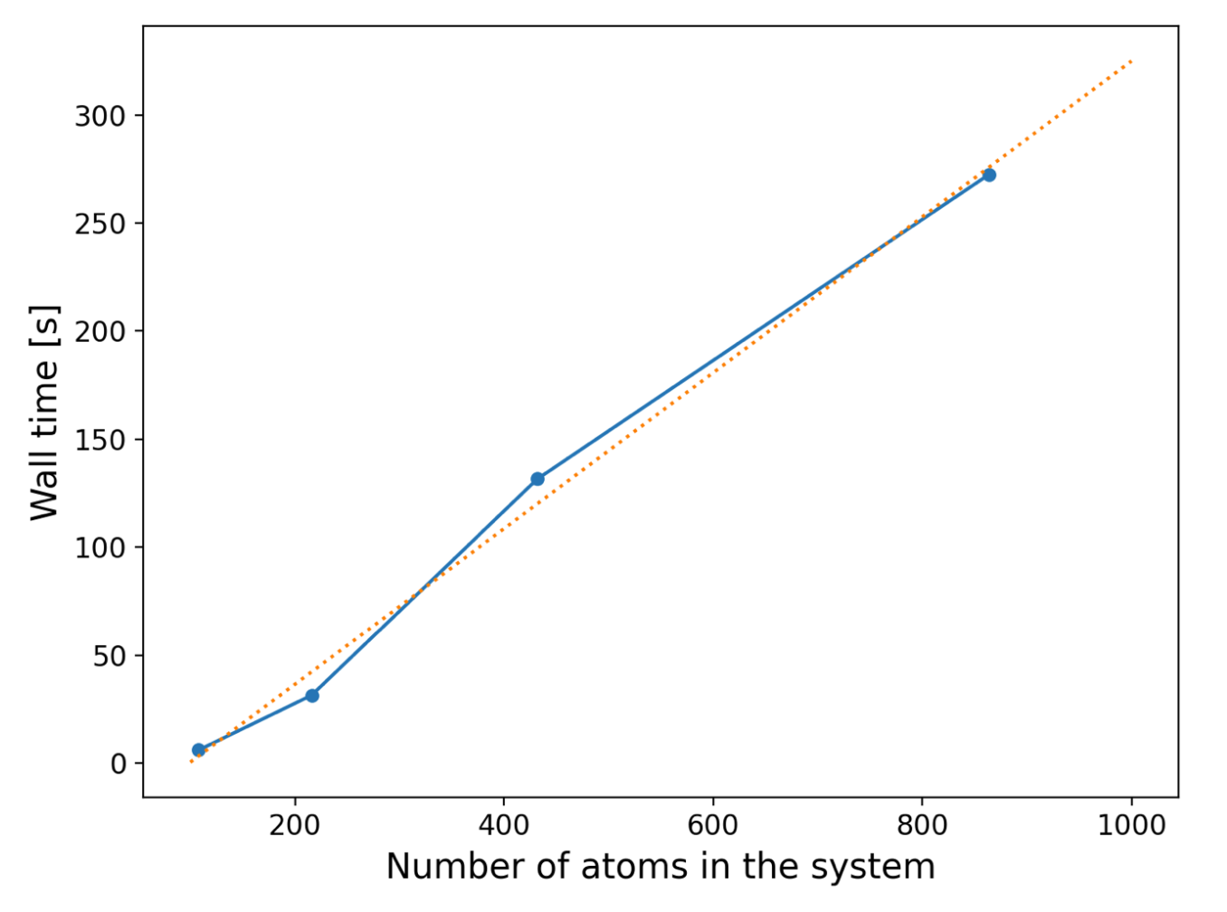
Example: Benchmark
Data at ./example/benchmark/backup_results
On the same problem defined in the last slide, we benchmark our program:
The total_steps is 100 for these simulations. They all start from the same initial temperature and atomic density.
MDS scales linearly in system size for this problem

Slide 12
Summary and Outlook
We implemented a program, MDS, for integrating Newton’s equations of motion with a given simulated ensemble and Lennard-Jones potential.
This code is designed to be easy-to-extend with new features, such as other boundary conditions, new force fields or new simulated ensembles.
Thanks!

